Slide 1
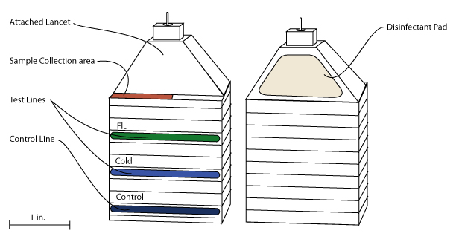
CAF-assay
The Cold and Flue Lateral Flow Assay
By: Michael Basov, Watson Blair, and Jon Prato

Slide 2
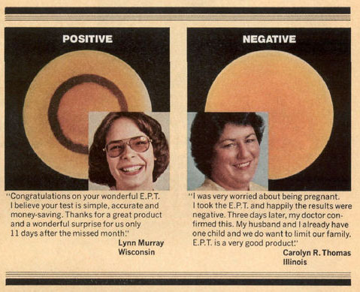
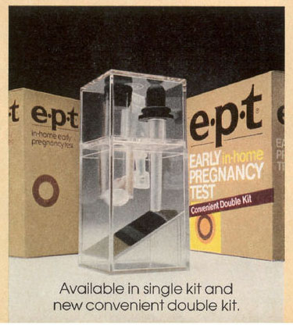
Lateral Flow Tests - History
have been a popular platform for diagnostic tests since their introduction in the late 1980s.
Based on technology developed in the 60’s
Driven by a need for point of care diagnostics

Slide 3
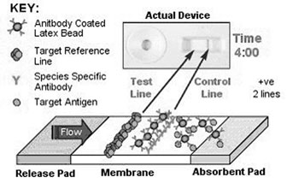
Lateral Flow Tests - Tech
Methods of detection:
Direct (Double Antibody Sandwich) Reaction Scheme
Competitive Reaction Scheme
Boulders-in-a-Stream” Strip Test Idea

Slide 4
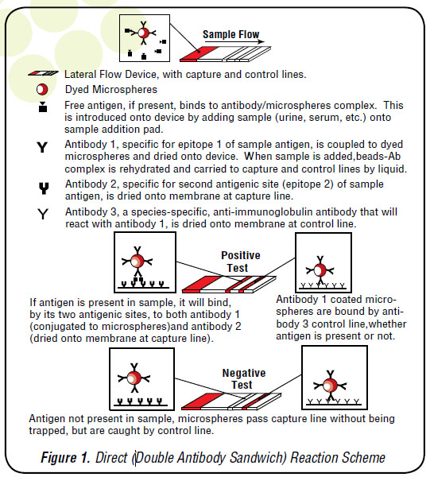
Direct Reaction Scheme
Opperates by binding free floating antigens in the sample, when the microshperes reach the test area the antigens bind to a second set of receptor sites and halts the microbead.
Any un-bound micro-beads are collected in the controll line to

Slide 5
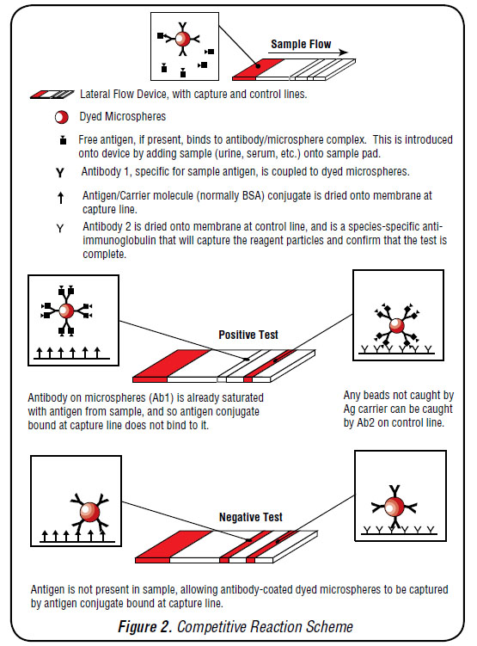
Competitive Reaction Scheme
This testing scheme is essentially the inverse of the Direct Reaction scheme. By binding antigens to all reaction sites on the micro beads, the micro beads are then unable to bind to the test area. In this assay, when no micro beads are caught in the testing area, the test is positive.

Slide 6
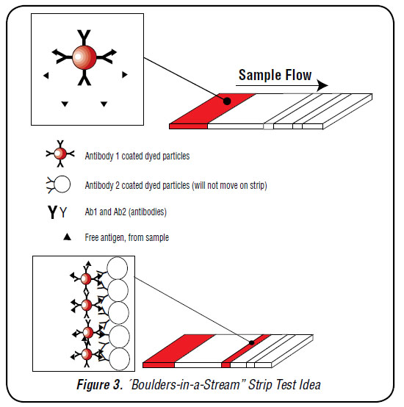
Boulders in a stream Test
This assay format utilizes un-dyed micro-beads as a capture method and makes migration of the mobile phase antibodies very efficient and reliable. The capture antibodies, rather than being physically bound by the membrane, are attached to large microspheres, which will be held in place physically, rather than chemically, while the sample passes by, much like boulders in a stream.

Slide 7
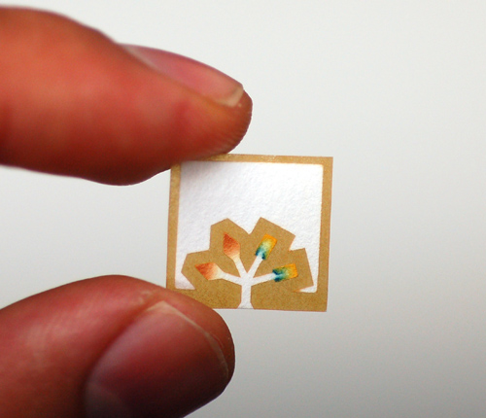
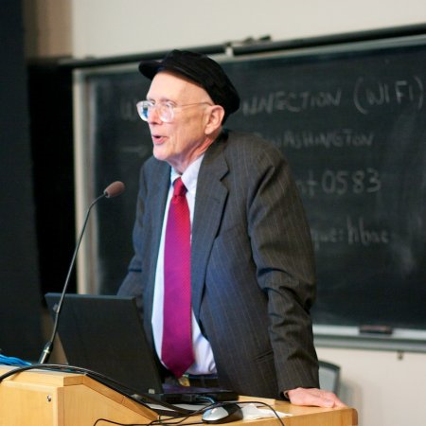
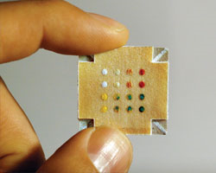
Recent Advances
2009 - George Whitesides introduced a new configuration for Lateral Flow Tests.
Cost Effective
Simple to produce
Idiot Proof

Slide 8
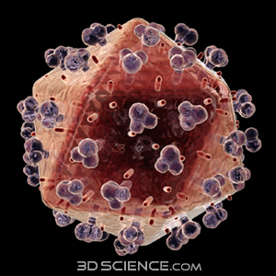
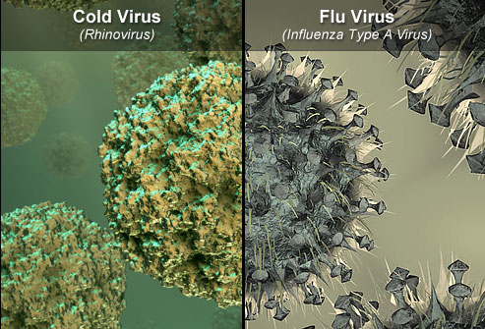
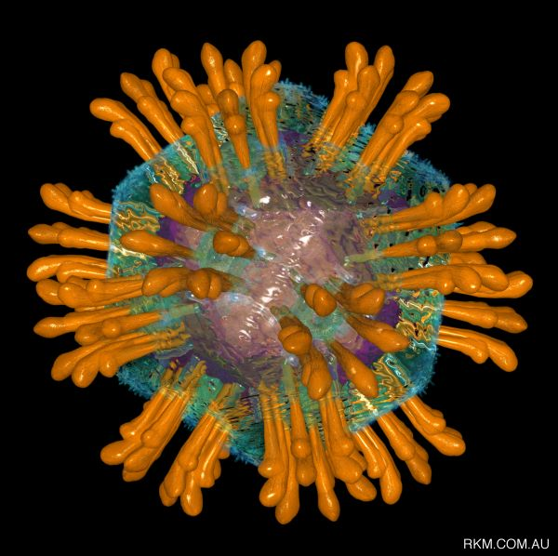
So what does this mean?
Tests can be created for any antigen with binding sites.

Slide 9
Why Test?
Reducing Misdiagnoses
Reduced cost on healthcare costs
Know with certainty which you have, cold or flu
Early diagnosis saves lives and shortens illness
Prevent people from developing terminal complications
Reduce effects of illness
Diagnostics in institutions could prevent an epidemic

Slide 10
Business Model & Objectives

Slide 11
3 year Objectives
Raise Series A Funding to develop CAF-Assay
Secure four long-term contracts in Year 1
Reach profitability by Year 2
Position ourselves as the leading home diagnostics company in the United States
Create a two tiered marketing approach

Slide 12

Start-up Capital
In order to develop CAF-Assay and start-up our company we will seek $261,500 in Series A Funding.
Item | Cost
Marketing | $20,000
Insurance | $5,000
Rent | $4,000
Equipment | $150,000
Website | $500
R&D | $40,000
Cash | $40,000
Legal | $2,000

Slide 13
Company Legal Structure
CAF-Assay plans to be a privately-held, LLC
Owners | % of Ownerhsip
Michael Basov | 20%
Watson Blair | 20%
Jonathan Prato | 20%
Biologist | 10%
Investment Pool | 30%

Slide 14
Market Overview
“Approximately 5% to 20% of the U.S. Population get the flu each year” – 307 million people
On average each person in the world gets the common cold at least once a year.

Slide 15
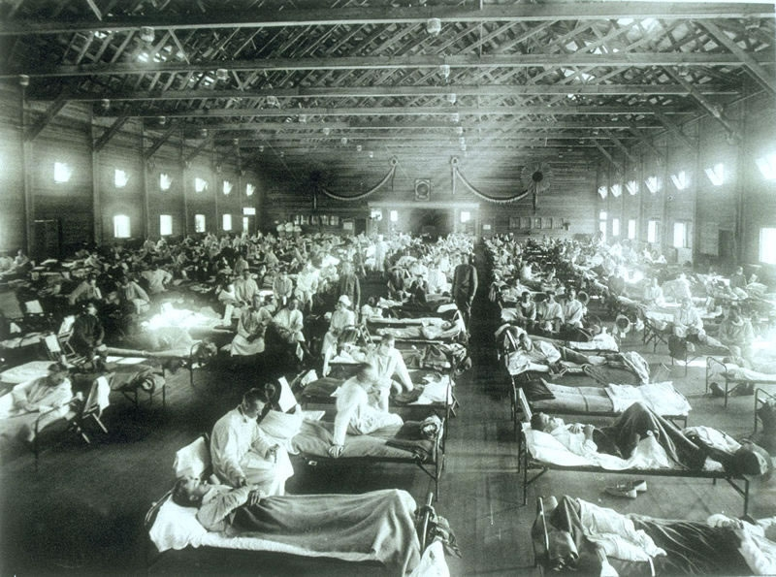
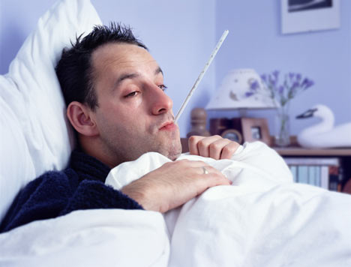
The Flu
Viral Pervasiveness: 5-15%
Cost: $71-167 billion per year
Body Count: 250,000 - 500,000 deaths.

Slide 16
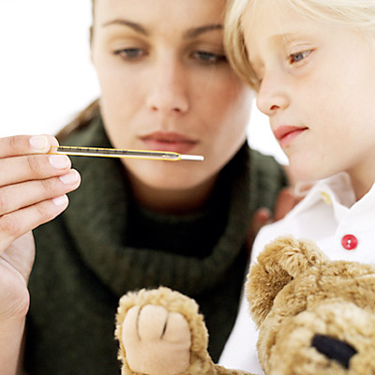

Cold
Viral Pervasiveness: 62 million
Cost: $7.7 billion per year
Body Count: 20 million school days and 22 million days of work.

Slide 17
Potential Customers
Primary Market (users of the test)
Elderly
Parents of Children (2-13)
Nurses
Secondary Market (distributors of the test)
Hospitals
Nursing Homes
Supermarkets
Physician Practices

Slide 18
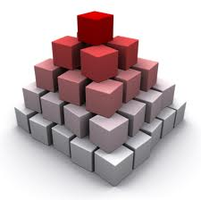
Two Tiered Marketing Plan
Top-Down Approach
Bottom-Up Approach

Slide 19





Competition

Slide 20

Operation Strategy
Marketing Strategy
Cost-Effective
Pricing Strategy
$3.50 Retail Price
Bulk Adjusted/Contract Pricing
Competitive Edge
Social Cause

Slide 21
Financial Management (P&L)
General and Admin Expenses
General and Admin Payroll | $0 | $0 | $0
Depreciation | $0 | $0 | $0
Leased Equipment | $0 | $0 | $0
Utilities | $3,000 | $3,000 | $5,100.00
Insurance | $1,920 | $2,880 | $5,040
Rent | $2,500 | $2,500 | $4,500
Payroll Taxes | $0 | $0 | $0
Total General and Admin Expenses | $7,420 | $8,380 | $14,640
General and Admin % | 19% | 14% | 14%
Other Expenses
Other Payroll | $0 | $0 | $0
Consultants | $15,000 | $0 | $0
Total Other Expenses | $15,000 | $0 | $0
Other % | 38% | 0% | 0%
Total Operating Expenses | $29,420 | $17,630 | $28,265
Profit Before Interest and Taxes | -$4,420 | $19,870 | $37,360
EBITDA | -$4,420 | $19,870 | $37,360
Interest Expense | $0 | $0 | $0
Taxes Incurred | $0 | $5,961 | $11,208
Net Profit | -$4,420 | $13,909 | $26,152
Net Profit/Sales | -11% | 23% | 25%
Pro Forma Profit and Loss
 | Year 1 | Year 2 | Year 3
Sales | $40,000 | $60,000 | $105,000
Direct Cost of Sales | $15,000 | $22,500 | $39,375
Production Payroll | $0 | $0 | $0
Other | $0 | $0 | $0
Total Cost of Sales | $15,000 | $22,500 | $39,375
Gross Margin | $25,000 | $37,500 | $65,625
Gross Margin % | 63% | 63% | 63%
Operating Expenses
Sales and Marketing Expenses
Sales and Marketing Payroll | $0 | $0 | $0
Advertising and Promotion | $1,000 | $2,000 | $4,500
Travel | $3,000 | $3,000 | $3,000
Reasearch and Design Expenses | $500 | $500 | $500
Miscellaneous | $0 | $0 | $0
Internet Marketing | $2,500 | $3,750 | $5,625
Total Sales and Marketing Expenses | $7,000 | $9,250 | $13,625

Slide 22
What’s Next

Slide 23
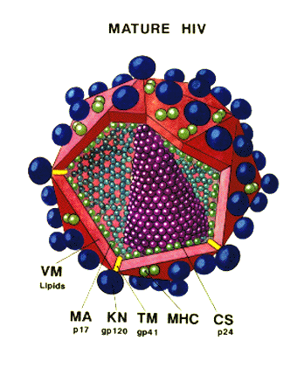
Testing for other Antigens.
The test receptors can be used to bind to almost any substance found in blood.
We can test for the presence of more serious diseases. (HIV, Hepatitis C, etc..)
Other Antigens we can test for include; poisons, toxins, heavy metals…

Slide 24
Versatile Stacking Design
We can expand the current tests to include similar diseases (ex. Stomach flu)
Expanding the test would be inexpensive. Each layer is mostly paper. No new equipment would be needed to expand the test.
Tests can be grouped by antigens that can cause similar symptoms or effect similar groups. (Ex. STDs, common poisons/toxins, seasonal diseases.)
3D test design lends itself well to alteration. Could be redesigned to be more portable/use less blood.

Slide 25

Potential other markets.
Other potential tests offer the ability to self-test, increasing privacy and convenience.
Lateral flow tests are cheap, portable and offer quick results.
Tests for non-evolving antigens (ex. Toxins) could potentially have a long shelf life.

Slide 26
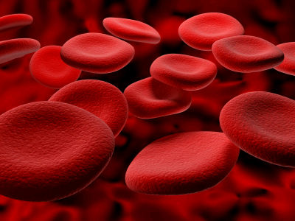
Other uses for this technology.
Binding particles to antigens could potentially be used as a filter.
Tests can be used for non antigens. (Ex. Different blood types).

Slide 27

Questions….?

